Slide 1



ENGINEERING BASICS
Ethioware - EdTech Initiative
BY: LENCHO TEREFE
JUNE 2025

Slide 2

INTRO TO ENGINEERING
IMAGINE THE WORLD WITHOUT ENGINEERING!
Engineering is the application of scientific and mathematical principles to design, build, and maintain structures, machines, and systems.
It involves creative problem-solving and the practical application of knowledge to meet societal needs.

Slide 3
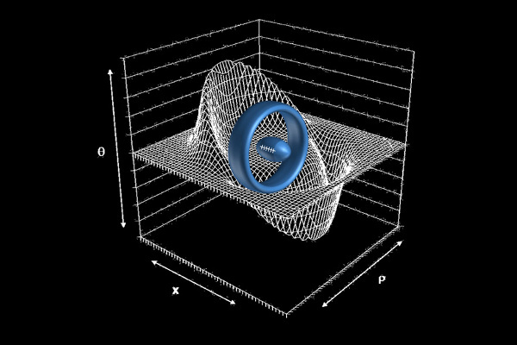
AP physics and AP calculus
AP Physics and AP Calculus are highly relevant and beneficial for students interested in engineering.
AP Physics provides a strong foundation in physics principles, which are fundamental to many engineering disciplines, while AP Calculus introduces the mathematical tools (derivatives and integrals) essential for modeling and solving engineering problems.

Slide 4
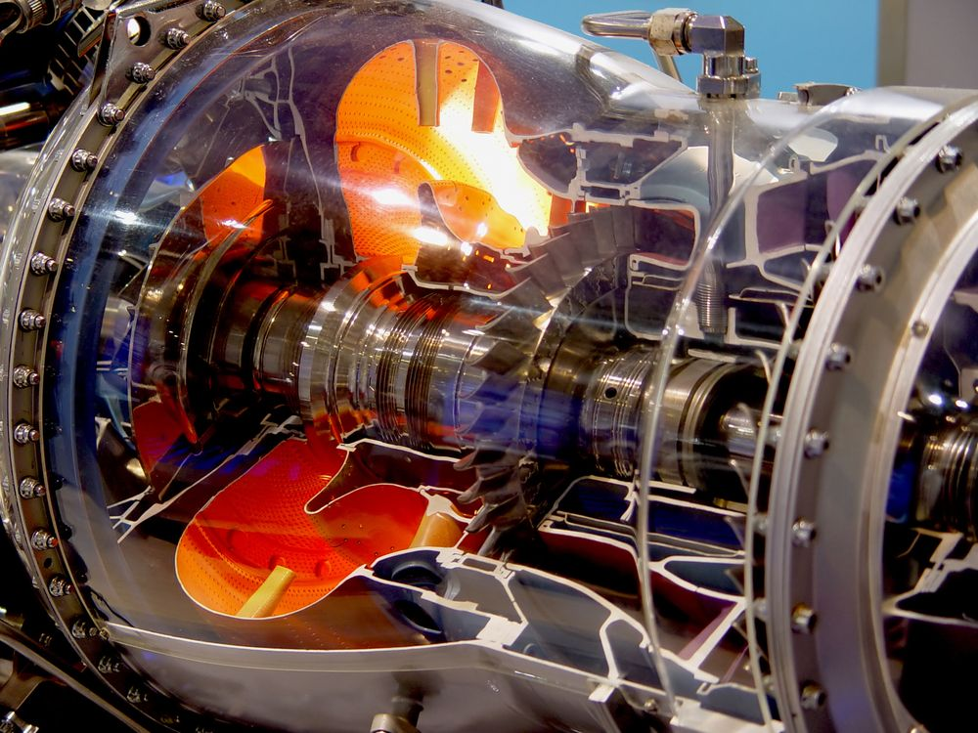
TYPES OF ENGINEERING
AEROSPACE
Aerospace engineering is a field focused on designing, developing, manufacturing, and testing aircraft and spacecraft
Aerospace engineers work in various industries, including:
Aviation: Designing and building commercial and military aircraft.
Space Exploration: Developing spacecraft, satellites, and launch vehicles for NASA and other space agencies.
Defense: Designing and manufacturing military aircraft, missiles, and defense systems.
Research and Development: Conducting research to advance aerospace technologies.

Slide 5

CIVIL
Civil engineering is the branch of engineering focused on the design, construction, and maintenance of the physical and naturally built environment, including infrastructure like roads, bridges, and buildings.

Slide 6
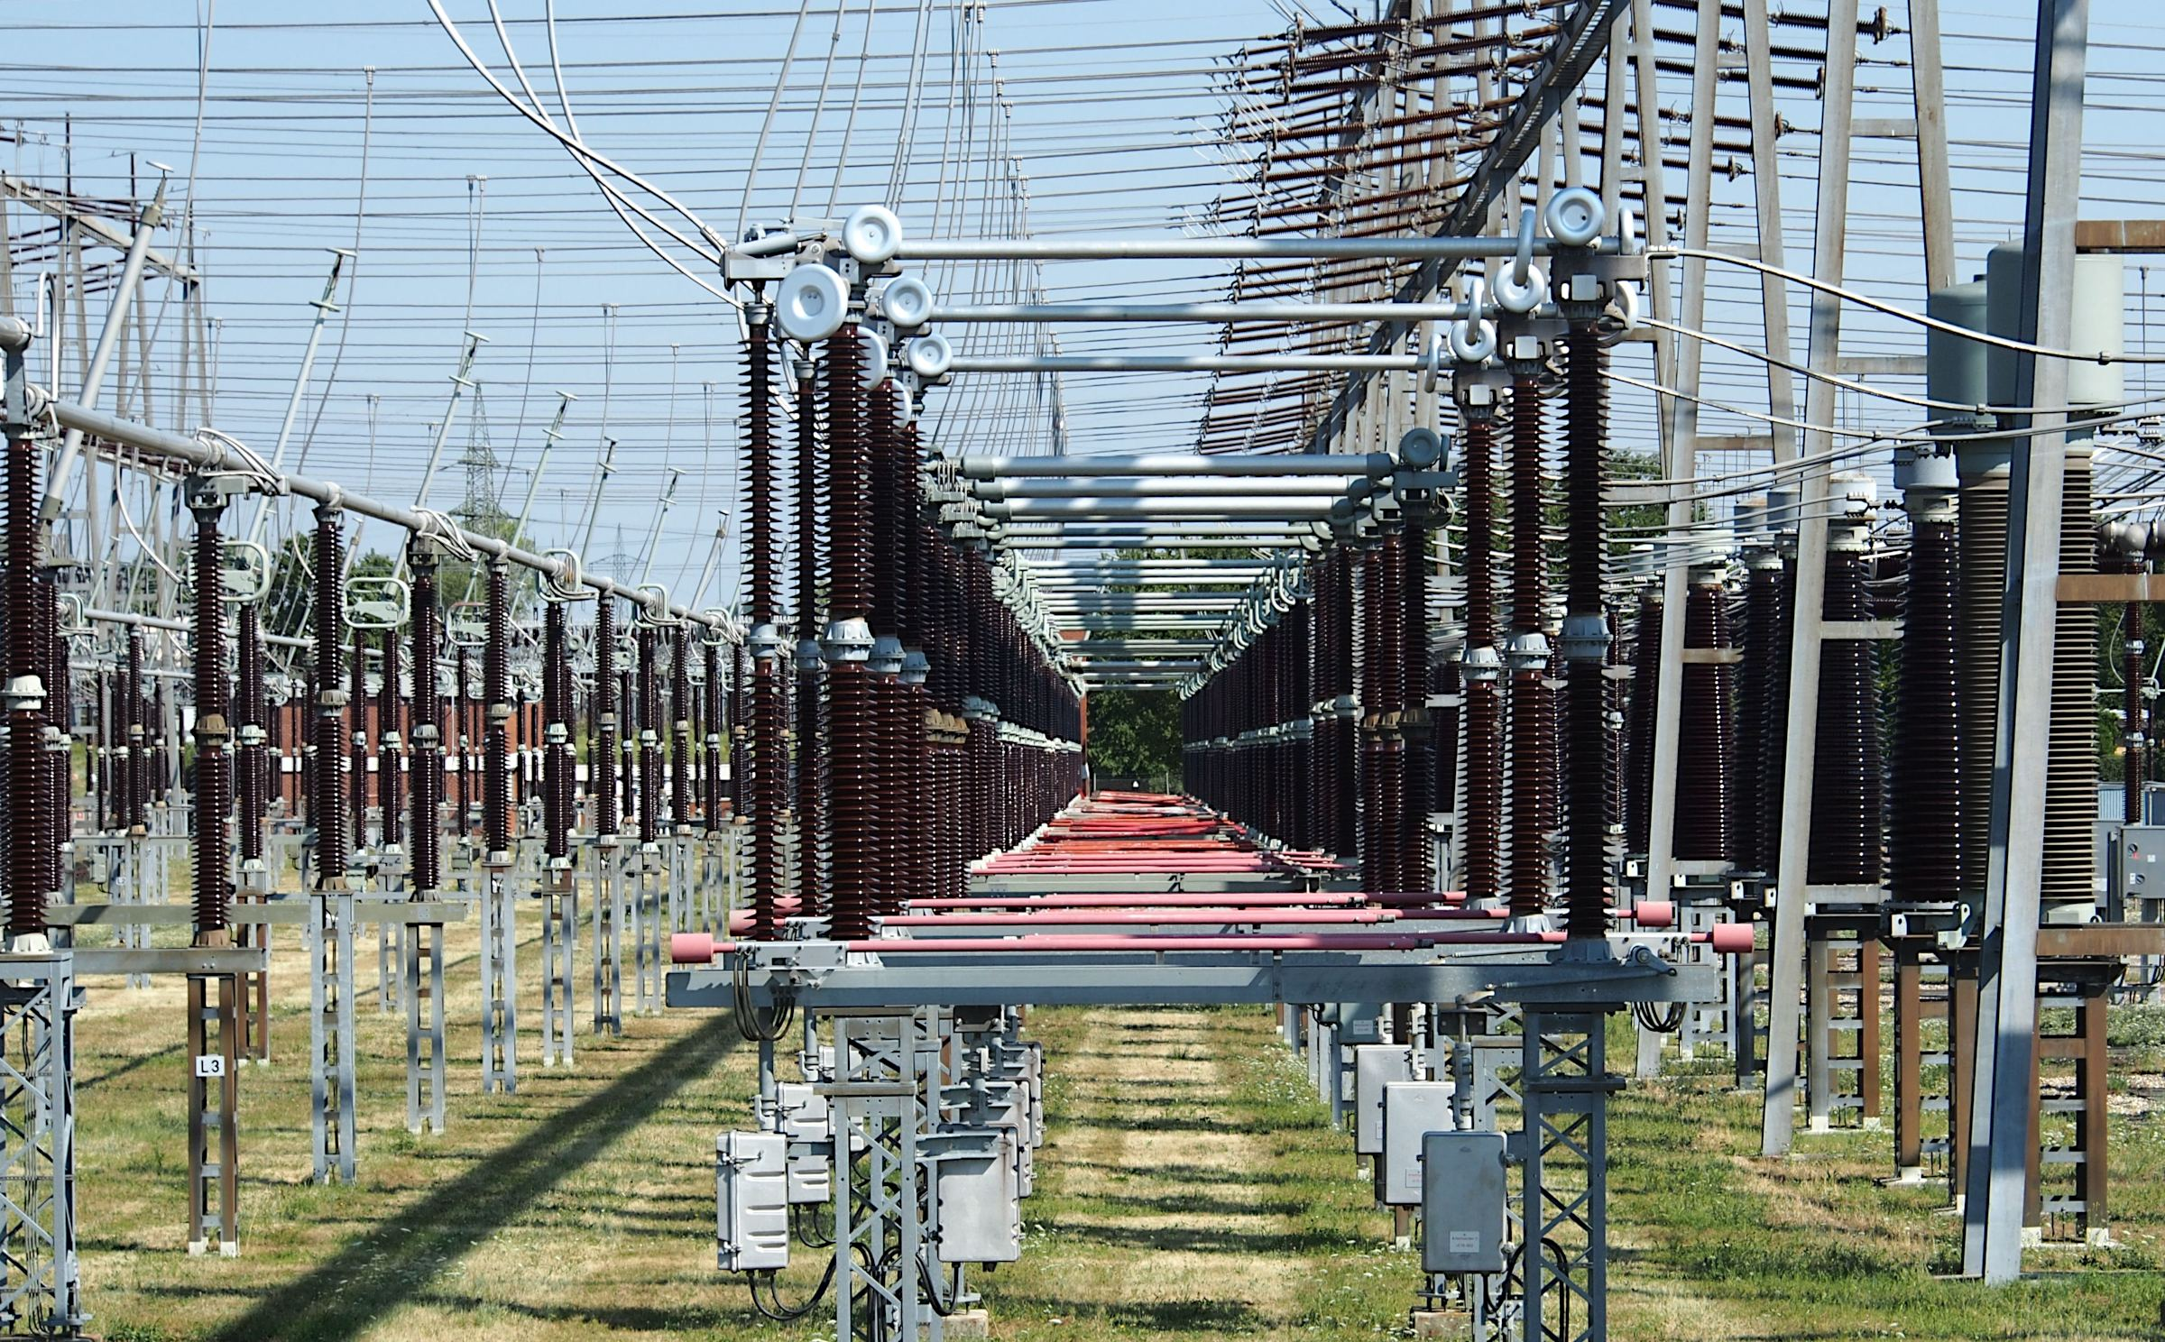
ELECTRICAL
Electrical engineering is a field focused on the study, design, and application of electrical and electronic systems, devices, and equipment.

Slide 7

MECHANICAL
Mechanical engineering is the study of physical machines and mechanisms that may involve force and movement.
It is an engineering branch that combines engineering physics and mathematics principles with materials science, to design, analyze, manufacture, and maintain mechanical systems.

Slide 8

SOFTWARE
Software engineering is a branch of computer science focused on the design, development, testing, and maintenance of software applications.
It applies engineering principles to create high-quality, reliable, and maintainable software systems.

Slide 9
SOFTWARE
Software engineering is a branch of computer science focused on the design, development, testing, and maintenance of software applications.
It applies engineering principles to create high-quality, reliable, and maintainable software systems.

Slide 10

My Course Experiences: Building a Strong Foundation
I. Engineering & Scientific Foundations
Understanding Core Engineering Principles: I gained a solid grasp of fundamental concepts common to all engineering fields, including forces, energy, materials, systems thinking, and the engineering design process.
Applying Physics Laws: I mastered key principles of classical mechanics (and potentially electricity and magnetism, depending on the AP Physics course) and applied them to analyze and predict the behavior of physical systems.

Slide 11
Cont’d…
II. Crucial Digital Literacy & Cybersecurity Awareness
Identifying Online Threats: I learned about various cybersecurity risks such as phishing, malware, identity theft, and social engineering tactics.
Protecting Personal Data: I understand best practices for securing my personal information, managing online privacy, and using strong, unique passwords.
Practicing Safe Online Habits: I developed habits for secure browsing, responsible downloading, and safe interactions on digital platforms.
III. Digital Engagement & Career Insights
Learning from Others' Pathways: Through various discussions and shared experiences, I gained valuable insights into the career and academic journeys of individuals.

Slide 12
Personal Growth: Before and After the Program
Before the Program:
- Limited understanding of core engineering principles and their real-world applications.
- Basic knowledge of physics and mathematics, but lacked confidence in applying them to solve complex problems.
- Minimal awareness of cybersecurity risks and safe online practices.
- Unclear about career pathways in engineering and the skills required to succeed.
After the Program:
- Strong Foundation:Gained a solid grasp of engineering fundamentals, including forces, energy, materials, and systems thinking.
- Applied Skills:Mastered key physics laws and mathematical tools (e.g., calculus) to analyze and solve engineering problems.
- Cybersecurity Awareness:Developed the ability to identify online threats, protect personal data, and practice safe digital habits.
- Career Clarity:Acquired insights into various engineering disciplines and career paths through discussions and shared experiences.
- Confidence: Improved problem-solving abilities and confidence in tackling real-world engineering challenges.

Slide 13
Conclusion
In summary, my coursework has provided me with a robust foundation in engineering and scientific principles, honed my analytical and problem-solving skills, and offered invaluable insights into future academic and career paths from the experiences of others. I am confident these experiences will serve as a strong springboard for my future endeavors.

Slide 14

THE END!!!

